Slide 1

BP Predictor
Lorna Migiro
Bernice Ndungu

Slide 2
Project links
https://web.microsoftstream.com/video/3162a6a8-3788-4f18-9258-2a1fc464f6fb.
GitHub Link
https://github.com/ksu-hmi/BP-Predictor

Slide 3
What was the idea?
Based on certain details like weight, age, glucose level, Cholesterol level, pre-existing conditions, etc we sought to predicts if one is prone to high blood pressure
We work to propose machine learning based healthcare analytics and maximize automated and continuous collection of user data .

Slide 4
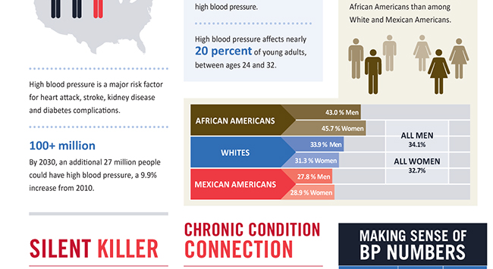

Slide 5
source code/tutorials
1. https://github.com/lmigiro/Blood-Pressure-Prediction-and-Peronalized-Health-Behavior-Recommendation
Used health and fitness data collected from Samsung Galaxy Watch and blood pressure data from Omron to realize blood pressure prediction.
2. Apple watch
This watch collects data such as a person’s heart rate, sleep cycle, breathing rate, activity level, blood pressure, etc. and keeps a record of these measures 24/7.
This collected data is then processed and analyzed by using Machine Learning and Deep learning algorithms to build a model that predicts the risk of a heart attack

Slide 6
Project development
We sourced for similar projects GitHub and online.
Initial code – we could not find the correct dataset
Current code- linear regression using sklearn
we made six major commits to the code

Slide 7
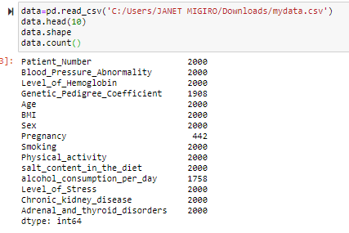
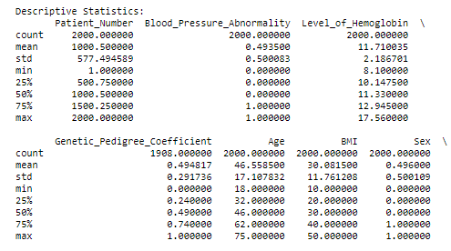
Data overview
Variables
Visualize different features and underlying relationships
Plotted histogram

Slide 8

Run code

Slide 9
ROADBLOCKS
Dataset
Packages installation on visual code
We used jupyter notebook

Slide 10
WHAT NEXT

